Slide 1




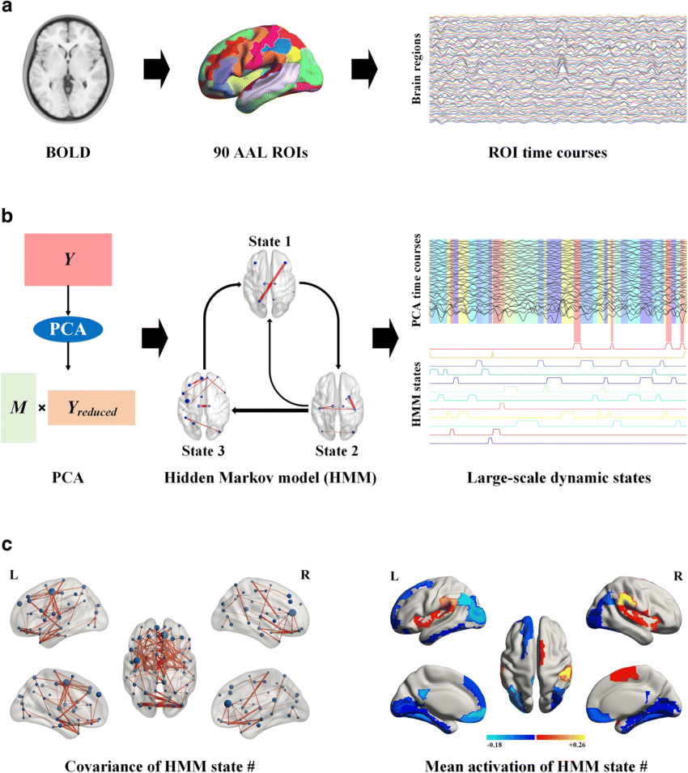
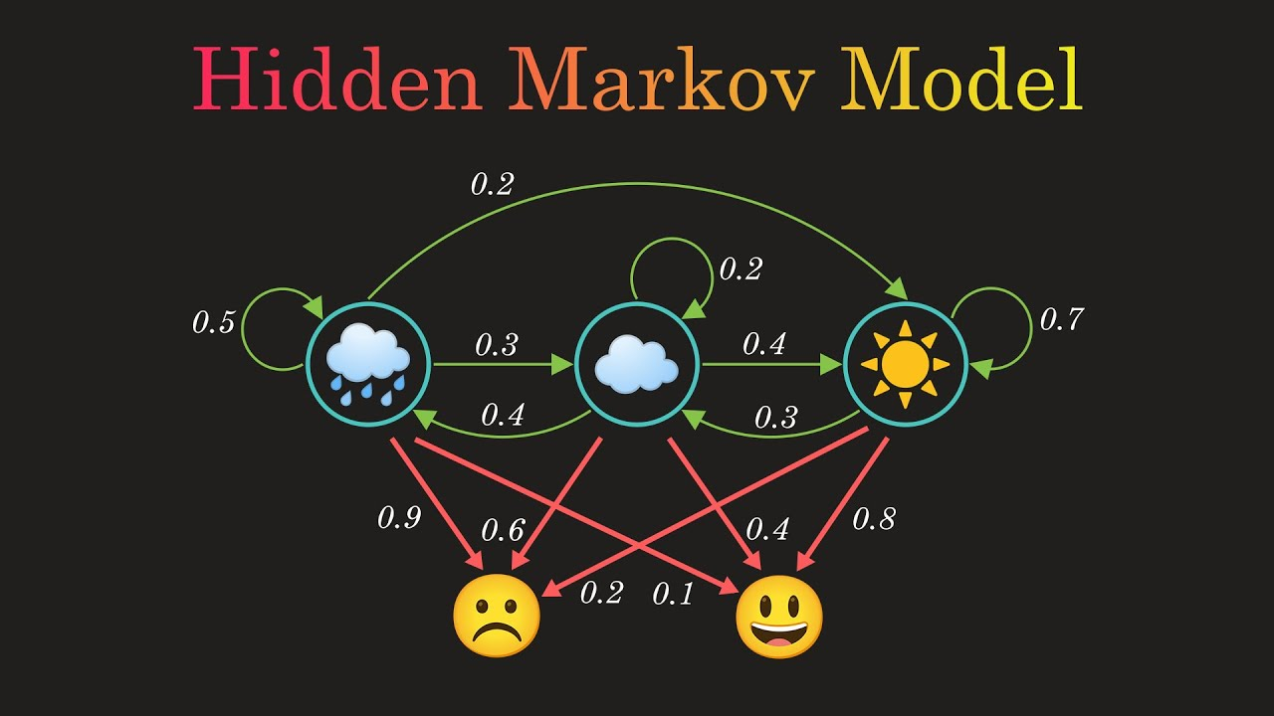
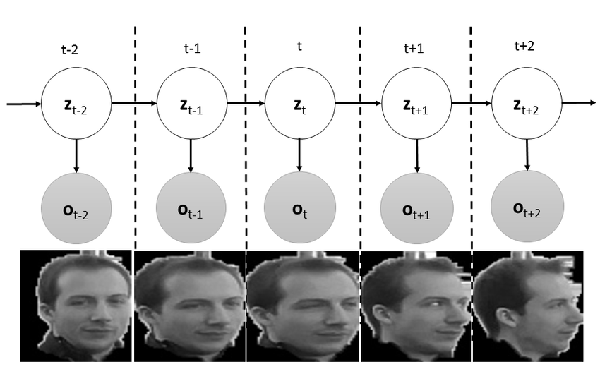
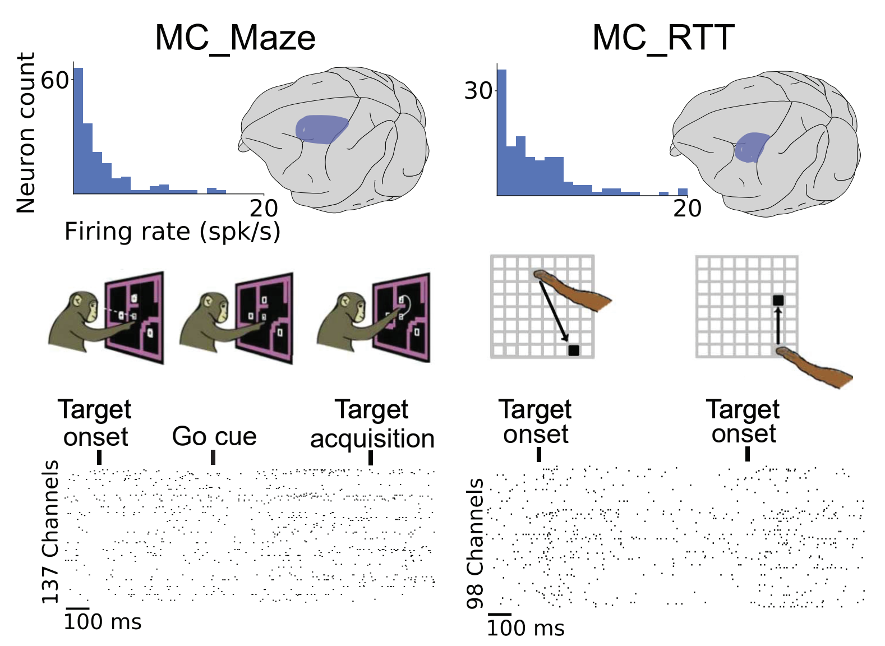
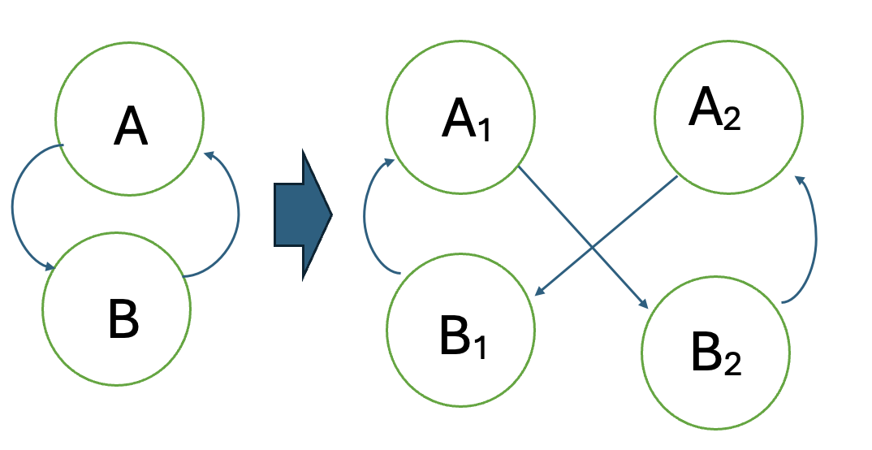
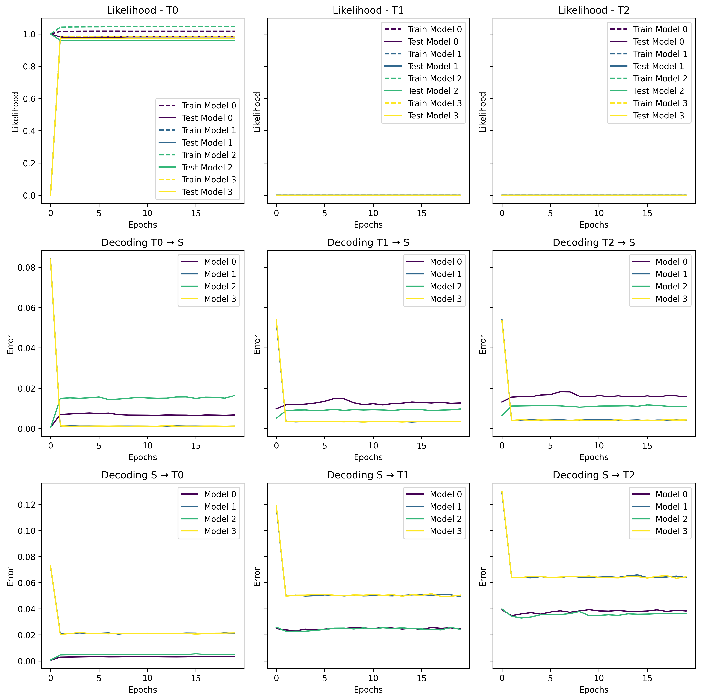
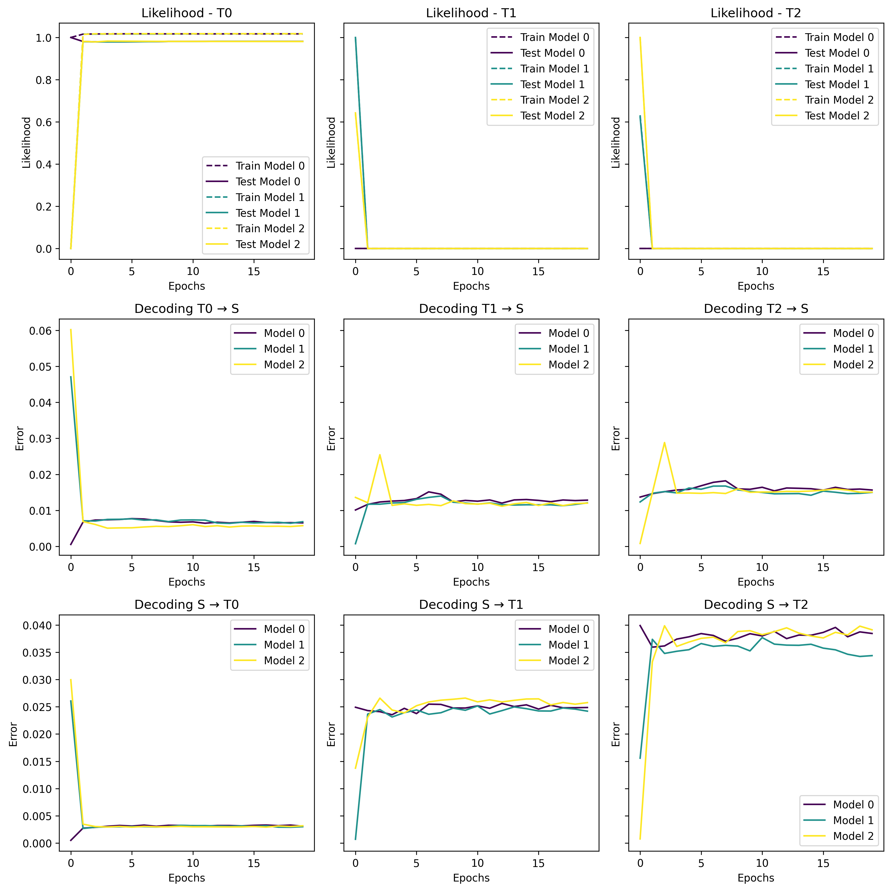
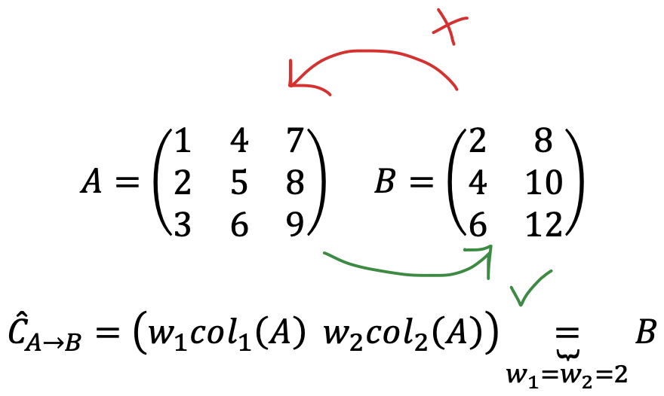
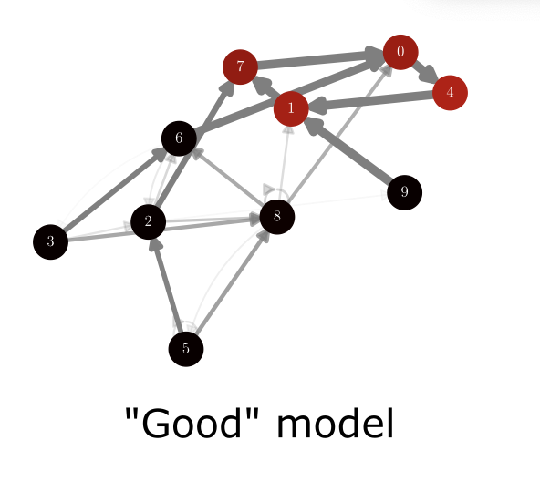
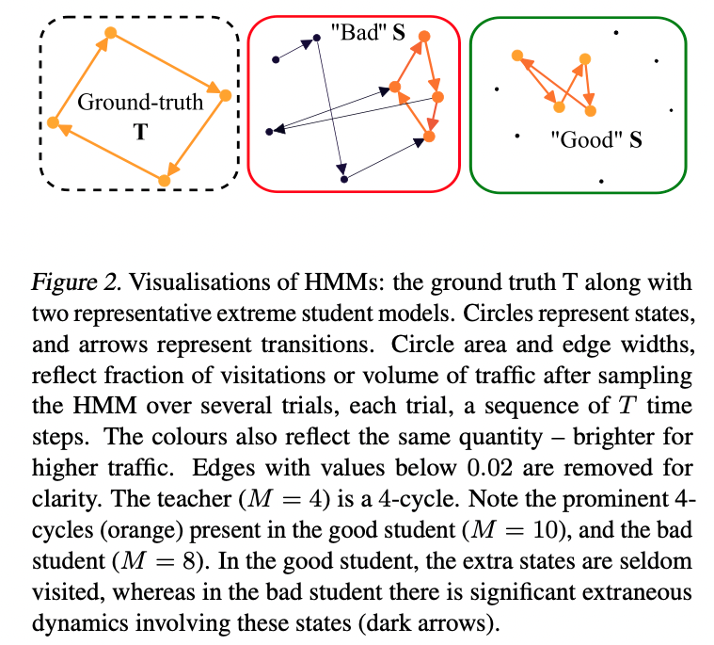
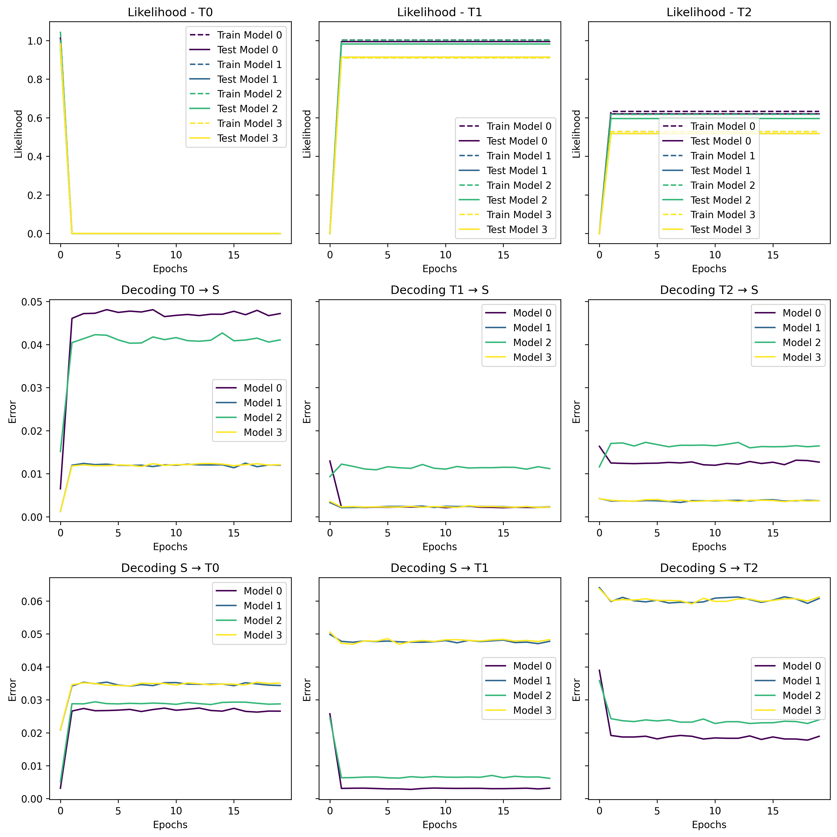
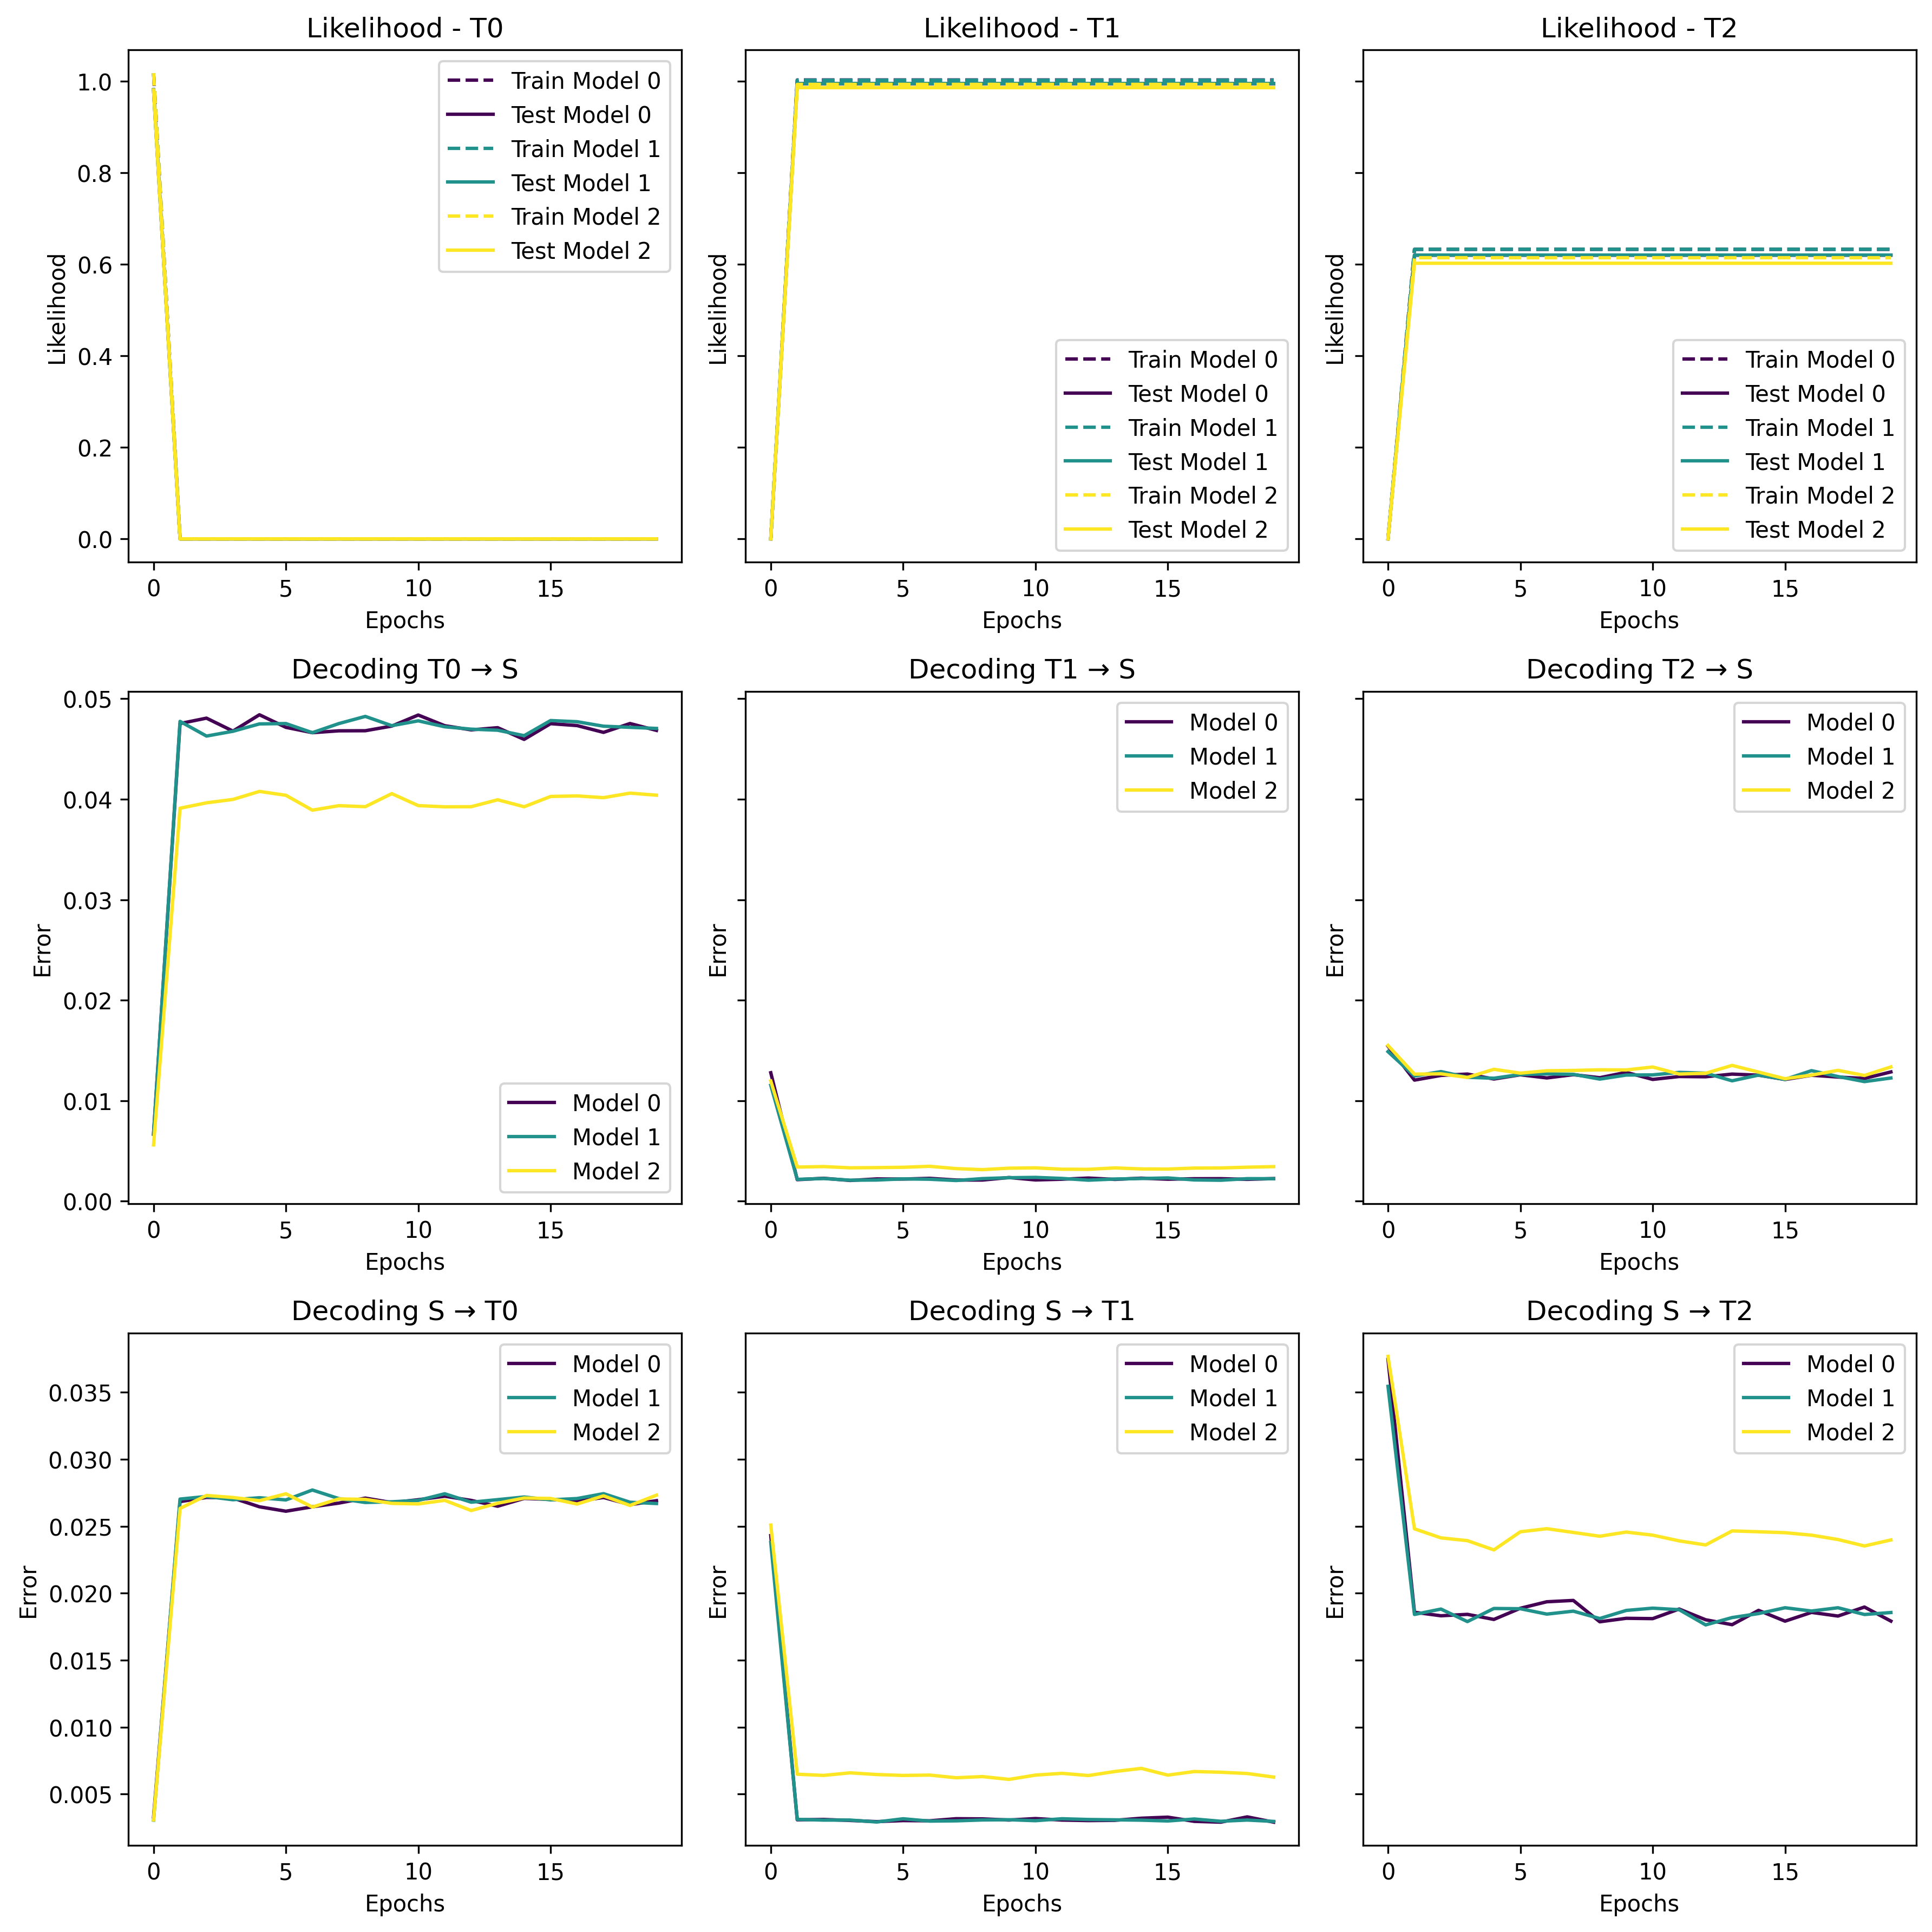
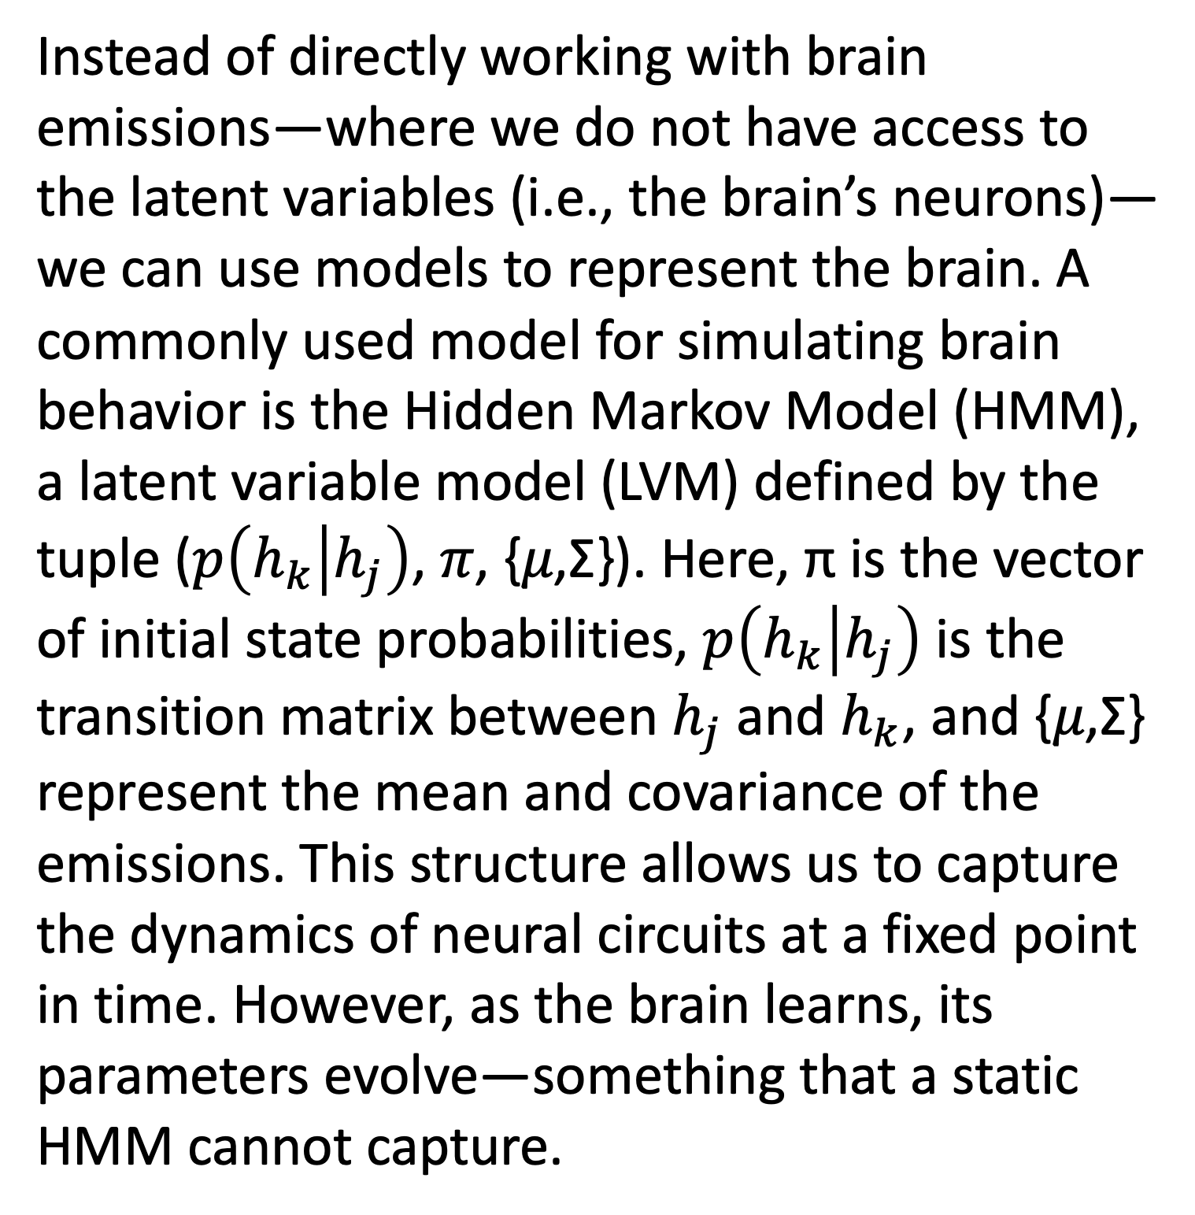
Effects of Changes in Time on Latent Variable Models of a Learning Brain
Arnold Cheskis | Supervised by: Kabir Dabholkar, Omri Barak
Motivation
Introduction
Approach
Developing a deeper understanding of latent variable models (LVMs) will help us find better methods to discriminate and find models that more accurately represent the brain’s inner workings, i.e. mimic the brain better. This will let us understand the brain better.
Instead of directly working with brain emissions—where we do not have access to the latent variables (i.e., the brain’s neurons)—we can use models to represent the brain. A commonly used model for simulating brain behavior is the Hidden Markov Model (HMM), a latent variable model (LVM) defined by the tuple ($p\left(h_{k} | h_{j}\right)$, 𝜋, {𝜇,Σ}). Here, π is the vector of initial state probabilities, $p\left(h_{k} | h_{j}\right)$ is the transition matrix between $h_{j}$and $h_{k}$, and {𝜇,Σ} represent the mean and covariance of the emissions. This structure allows us to capture the dynamics of neural circuits at a fixed point in time. However, as the brain learns, its parameters evolve—something that a static HMM cannot capture.
There are several approaches to overcome this problem. The one pursued in this study is to examine how data over time from a learning brain influences the performance of LVMs, potentially helping to identify the ground truth, i.e., the brain’s model.
The Problem
Methods
We cannot access the configuration of the brain’s latent variables—i.e., the neurons. Therefore, we must rely solely on data from the electrodes, i.e., the brain’s emissions.
While multiple models can achieve high accuracy (likelihood) on the emissions, which ones actually share the same latent parameters as the true model (the brain)?
To represent a learning (optimizing) brain, we begin with randomly initialized HMM models, as described in the introduction, and apply perturbations. Then, using a student-teacher setup, we initialize random and artificially created student models, train them on the teachers, and observe differences in decoding and likelihood scores.
Project specifications and mid ppt
An example of an artificially created student, with a wrong latent structure but with a high likelihood score.
Results
Example of 1-sided good performance on decoding. Here only A, its 2 left columns*2, decode B.
The figure on the left shows the students’ performance during the fitting to the emissions (train data) of T0 and on the right the teachers’ (ground truth) performance. In each figure, the left column shows performance on T0’s data, the middle T1, and the right T2. The first row shows the likelihood over time, the middle shows the trained model decoding score of the ground truth, and the lower shows the ground truth’s decoding of the trained models. The lower the decoding in both ways, the more similar the models are expected to be. We can see that
Conclusions
First
Similarly, the figures above show the same graphs, except this times the models have already been trained on T0, and are now trained on T1.
April 2025

